Slide 1
Artificial Intelligence around us
Dinesh Kumar P
Product Manager
Kissflow

Slide 2

Artificial Intelligence

Slide 3
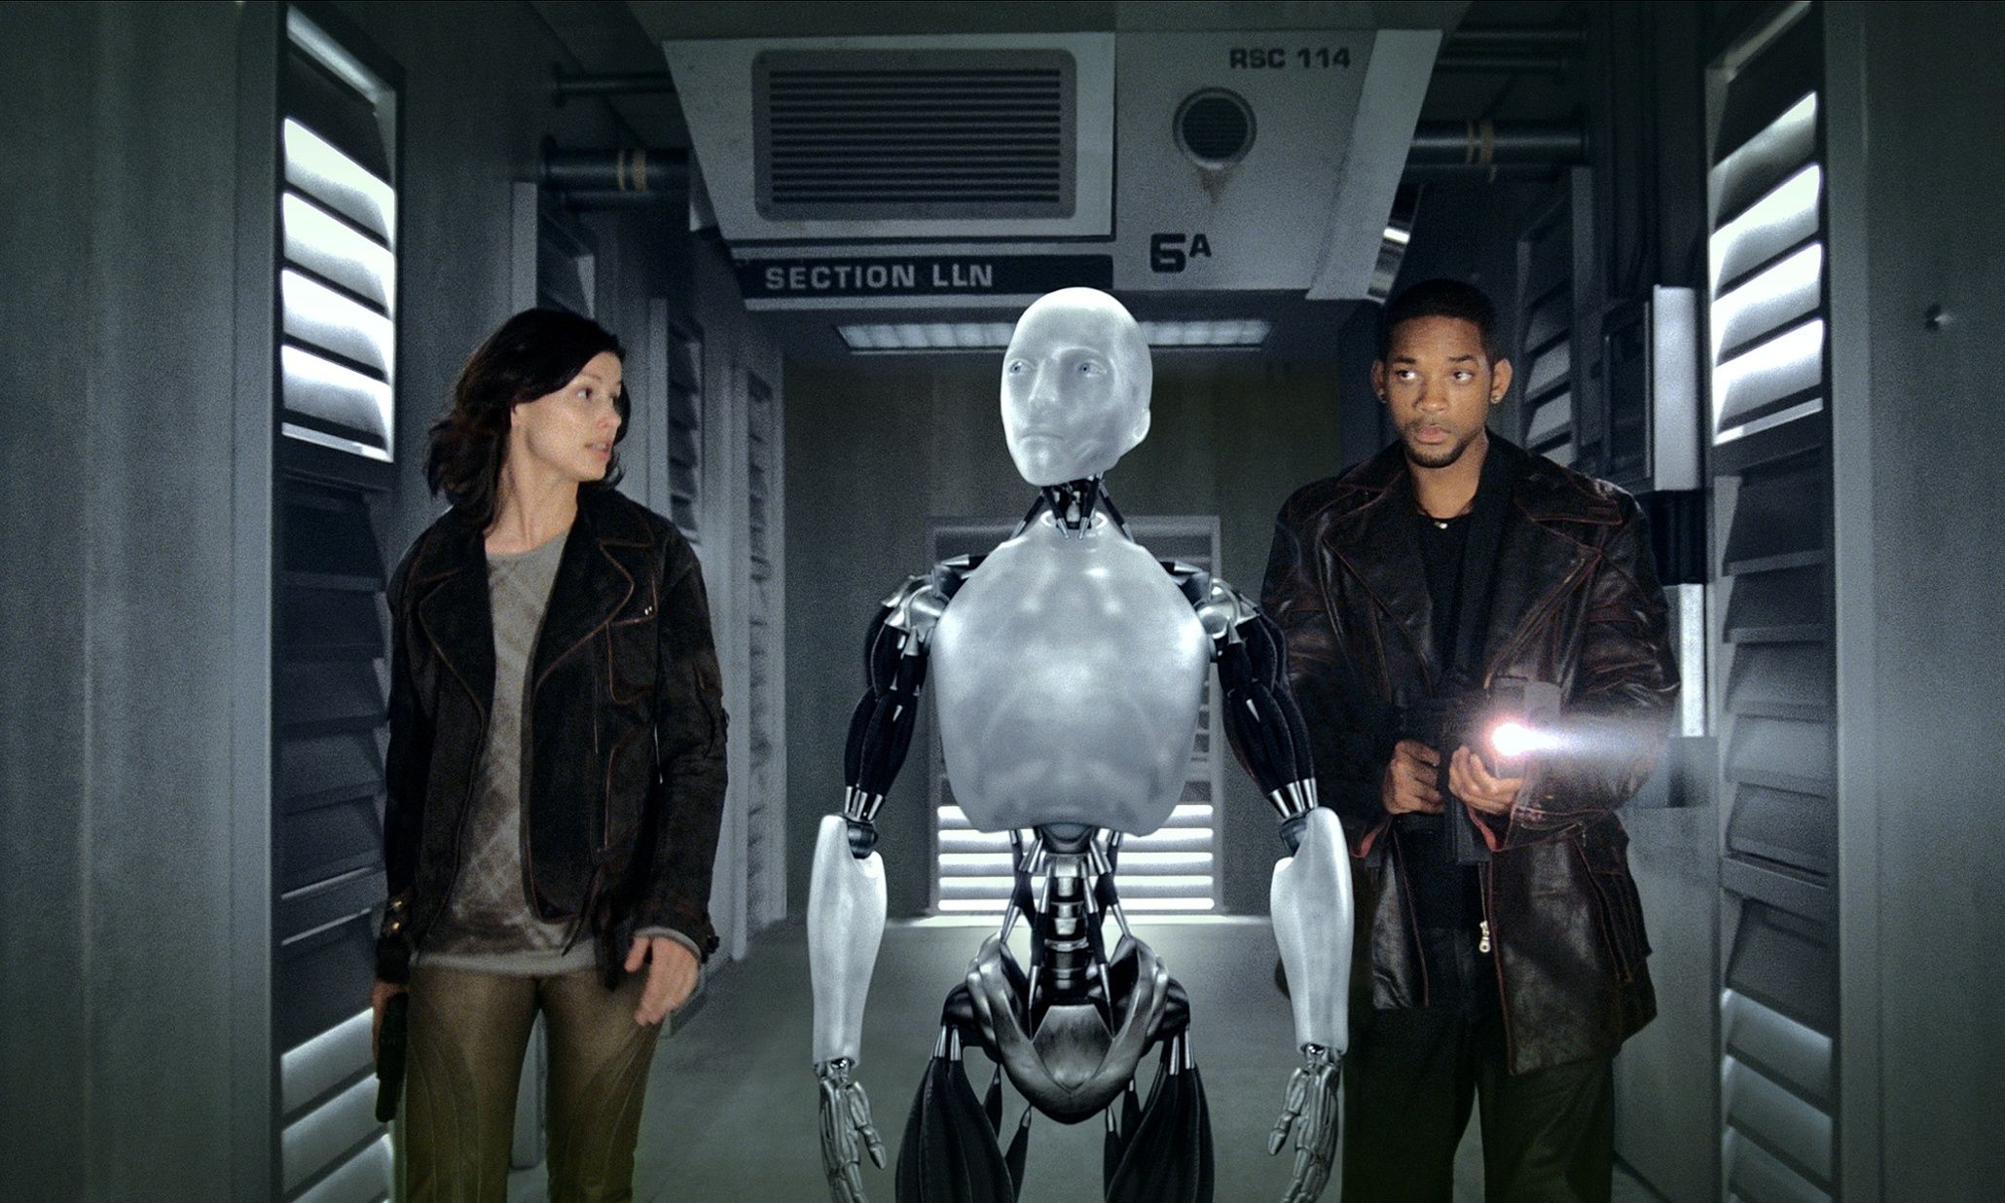
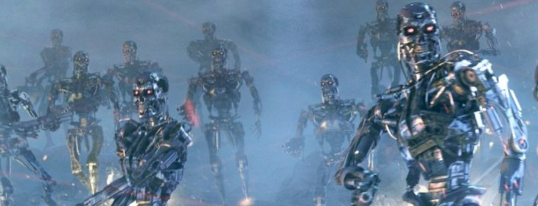
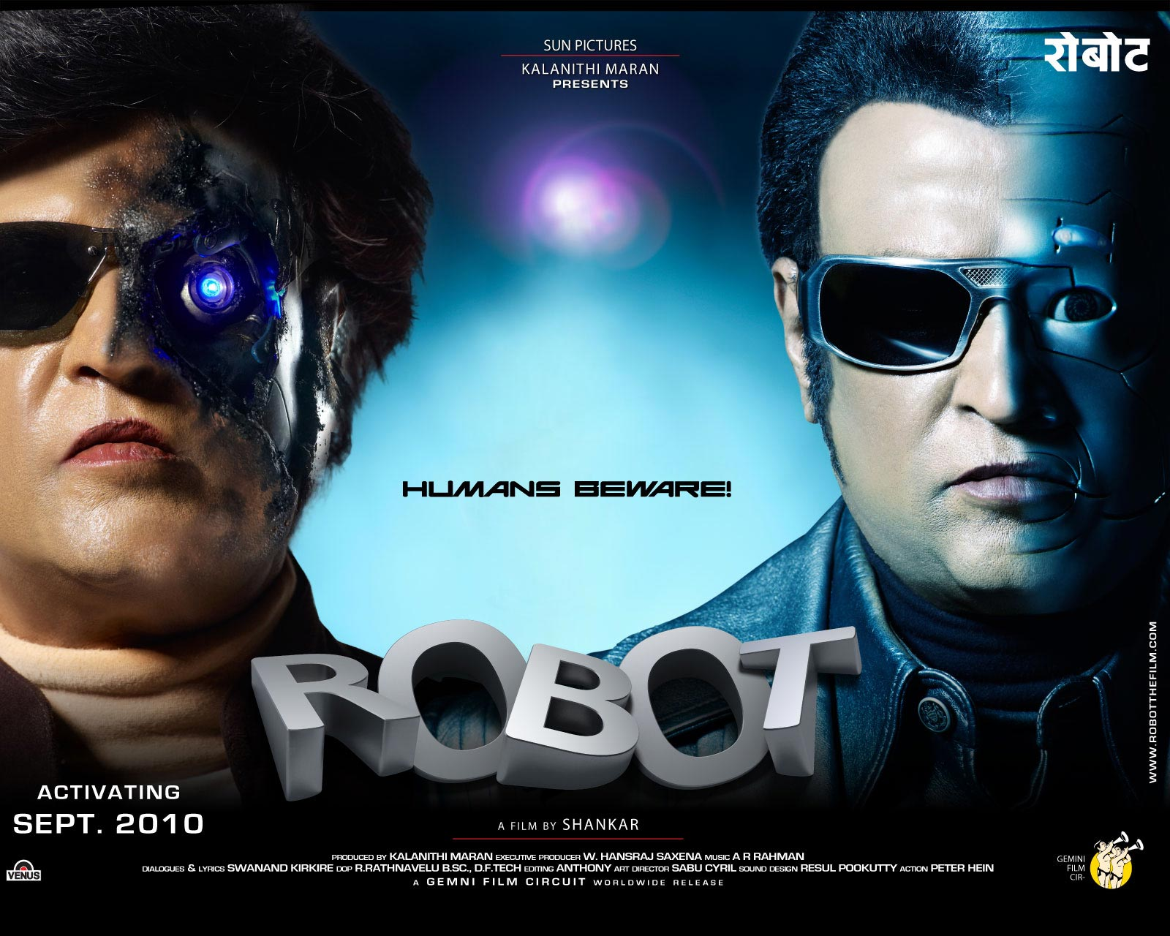
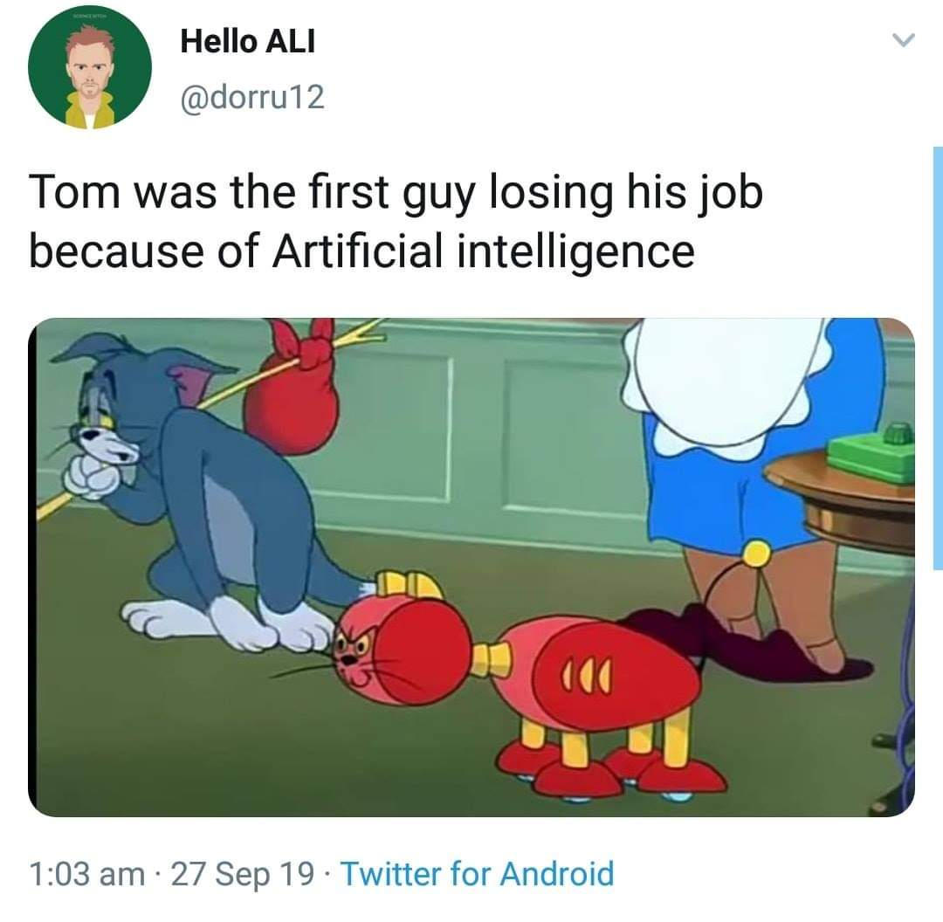

Slide 4

For what quality some people get a higher paid job?
1,00,000
70,000
50,000
25,000
Notes:
Let me ask a simple question. For what basic skill, different people get different salary? Perhaps that is the same basic thing which all the ML or AI projects are solving and make our life easier.

Slide 5



Decision Making
Notes:
Its DECISION MAKING. And that’s what AI is doing for Humans right? I can say many real time examples for this. For now, lets take - the Google Maps. Before 5 years, if you are riding to a destination for which you don’t know the route, you will constantly ask the persons who are on your path way, think over the route and go on. But now, Google Maps in our mobile phone, decides and tells this is the right route. And we are travelling just by looking into that Map path. Notice that here decision making work is partially taken over by the software comparing to the same situation before 5 years.
Software are no more just software. As engineers, we are making them as intelligent agents and make them evolve as more human in nature. Simply say, future machines with software will slowly rise to the conscious level of humans even!

Slide 6
Every progress in a work Driven by decision making
Programmer decides,
If branch (or)
Switch statement
Business man decides,
More discount (or)
Kind words

Slide 7
Features make humans different from machines
Taste,
Odour,
Thought,
Vision,
Speech,
Hear
Feel

Slide 8
Nowadays you can see these in Machines
Thought,
Vision,
Speech,
Hear
Notes:
Data Scientists and Machine Learning Engineers are working hard to recreate the sense of thought, hearing, speech and vision in machines. In the upcoming hour all we are going to see is around these features.

Slide 9
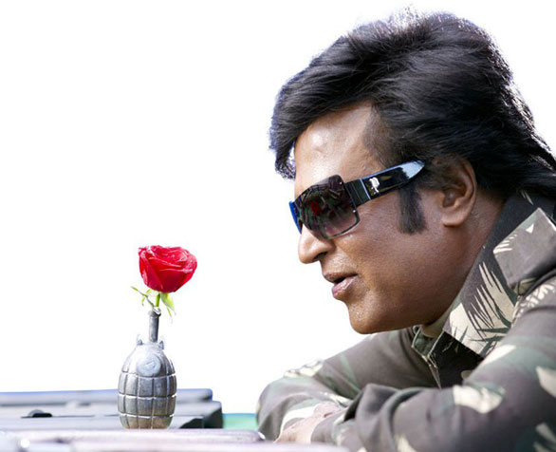

Feel

Slide 10
Machines - Understand and speak our language. - Understand what we see.

Slide 11
Examples

Slide 12
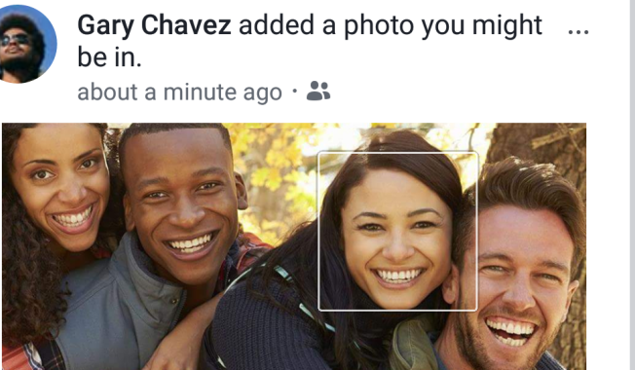
Thought
Facebook recognize like a human brain and suggests auto-tag while uploading a picture.

Slide 13
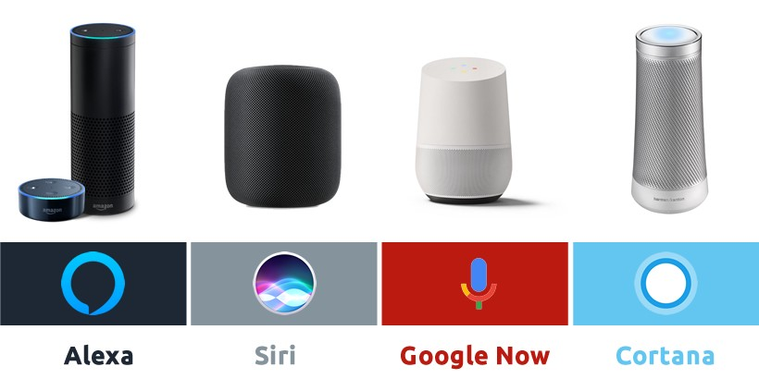
Hear and Respond by Speaking
Google Assistant
Siri
Alexa
Cortana
Notes:
Natural Language Processing

Slide 14
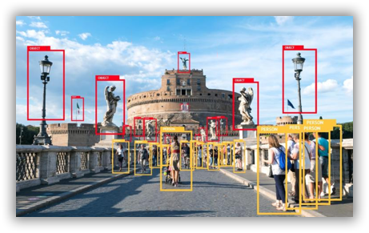
Vision
Surveillance
Capturing traffic violations

Slide 15
Human’s features into machines. WHY?

Slide 16
Impossible actions like Rescue missions
Accuracy – Consistent and Known level.
Speed
Notes:
Machines match or overtake human intelligence.
- Rescue missions – Bore well, Mines.
-
- Consistent and Known Accuracy.

Slide 17
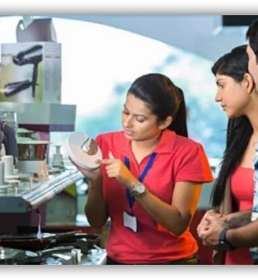
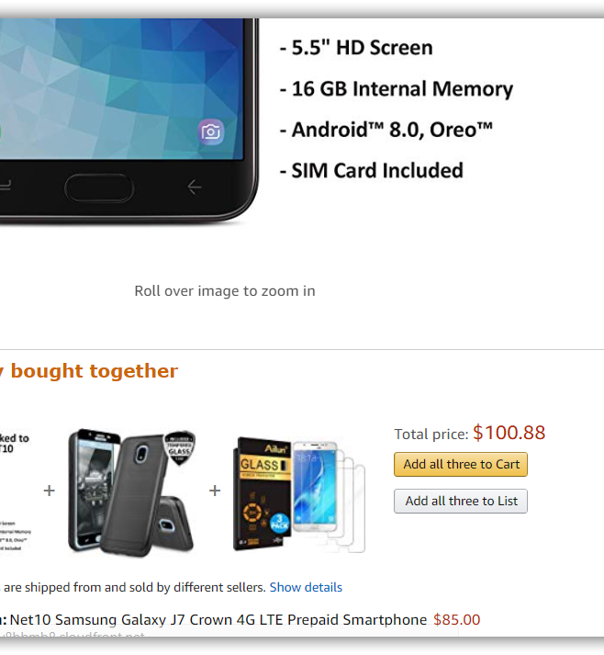
Notes:
Question:
The right side image - Where do you see such a thing?
Human may get tied. Vary in the process at times / situations. (Morning fresh, Evening tied)
Machines always perform as 100% until it is given the electricity power.

Slide 18
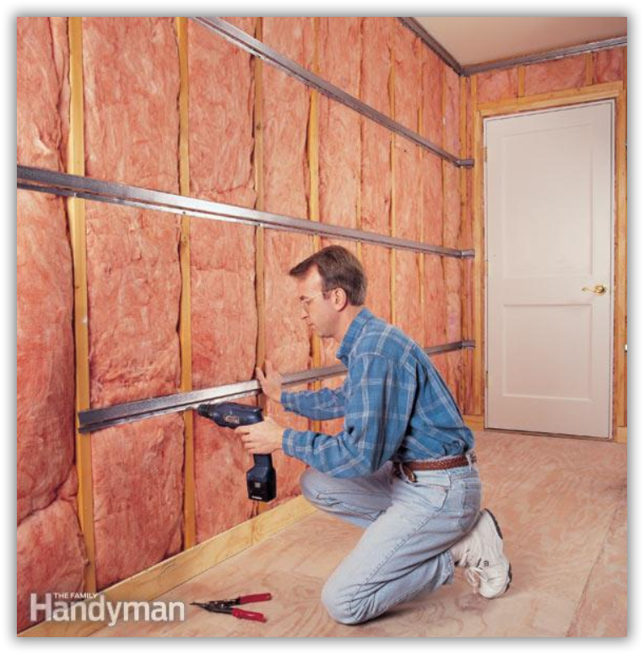

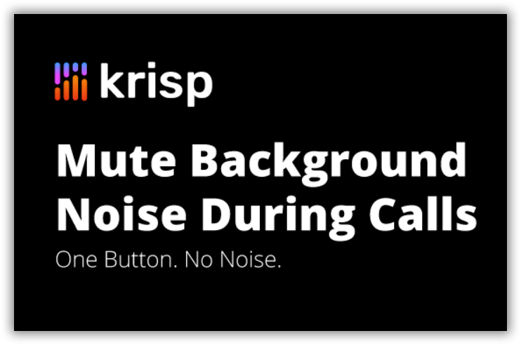
Notes:
How many of you create YouTube videos here?
What do you do for recording a noise free video?
To record tutorial videos, in my own company we were evaluating multiple options. The left most – Sound proof room, Center – Noise cancelling MIC, Right – You could see a software that does all noise cancellation works.
Guess what we choose? It’s the noise cancelling software. It was way cheaper with our expected Quality. Now should I or my company think that did we make lose a job of a worker or a made loss for company who sell that MIC? Weird na?

Slide 19
Can you Answer?
4 features of humans nowadays in machines?
Notes:
Thought, Vision, Speech, Hear

Slide 20
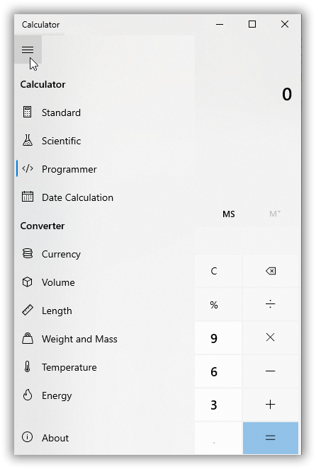
Notes:
Question:
Calculator has a lot of features. Its fast, efficient than most of the humans. So is this another example for Artificial Intelligence like previous chess game?
NO. Calculators do not have decision making abilities. So you cannot consider calculator as a AI device.

Slide 21

Notes:
Played HUMAN vs COMPUTER chess game? We Human will be efficient at times and not some times. But the opponent Computer wont get tied any number of times you play.

Slide 22
Can you Answer?
For what quality some people get a higher pay?
Notes:
DECISION MAKING

Slide 23
The term “Artificial Intelligence” was initially put forth by John McCarthy in 1956 when he held the Dartmouth Conference, which was the first academic conference on the subject.

Slide 24

AI vs ML

Slide 25
What is Machine Learning ?
A program that looks for patterns in existing data.
Recognize those pattern in new Data

Slide 26
What Machine Learning do?
Predicting future
Organizing or Grouping

Slide 27
Features vs Labels
Enter Text
Features
Input
Labels
Output
Name, Amount, Where Issued, Age of Cardholder
Genuine/Fraud

Slide 28
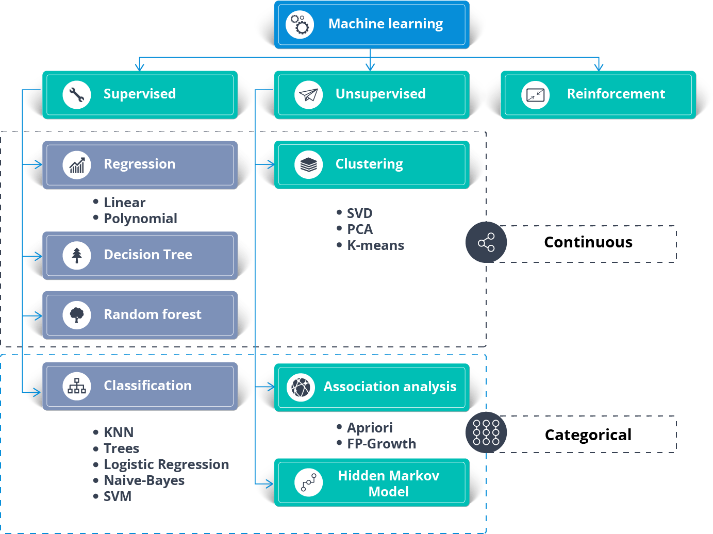
Types of algorithms

Slide 29
Five Questions
Enter Text
1. Is this A or B ?
2. Is this Weird ?
3. How much or many ?
4. How this is organized ?
5. What should I do next ?
Notes:
Classification – Is this a cat or dog?
Anomaly Detection – A US citizen suddenly swipes his credit card in a different continent he never visited.
Regression – How much the gold price will increase after a week?
Clustering – Gmail automatically organizes as Primary, Social, Promotions.
Reinforcement – Self driving Car

Slide 30
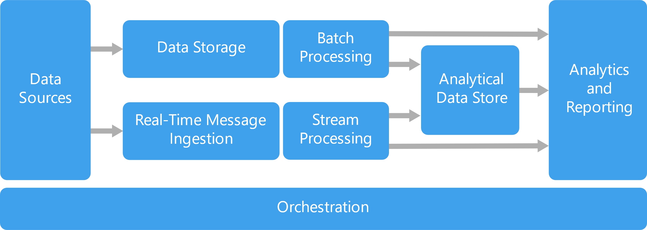
Notes:
Processes involved in a typical data project or any projects that ends with delivering something for decision making.

Slide 31
Jobs around DATA
Which raw data to use? - Almost all.
What kind of environment should I setup? – More of Big Data Admin.
How raw data be processed to create prepared data? – More of Big Data Developer.
Identify Combinations of prepared data and machine learning algorithms should you use to create the best model? – More of Data Scientist.
All these analysis as dashboard / report for decision making. – More of BI specialist.
Notes:
Inspite we are not called as Data engineers, we will be coming across any of these questions at some point of our work.

Slide 32

Few more examples?

Slide 33
Bots in PUBG mobile play games.
Prediction of routes in Google Maps.
Credit risk assessment.
AI-powered cameras in Android phones especially portrait mode detecting depth.

Slide 34
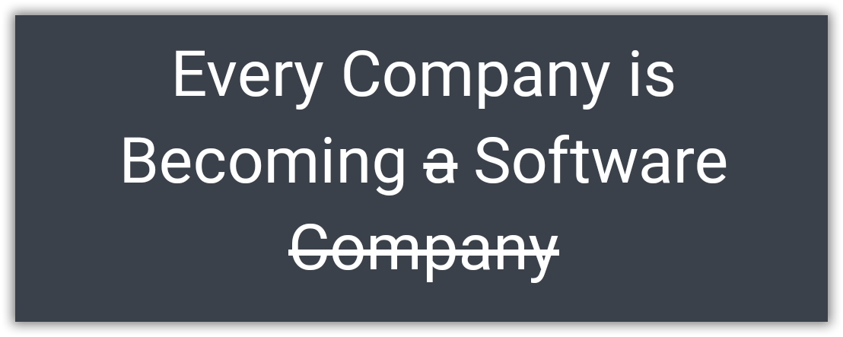
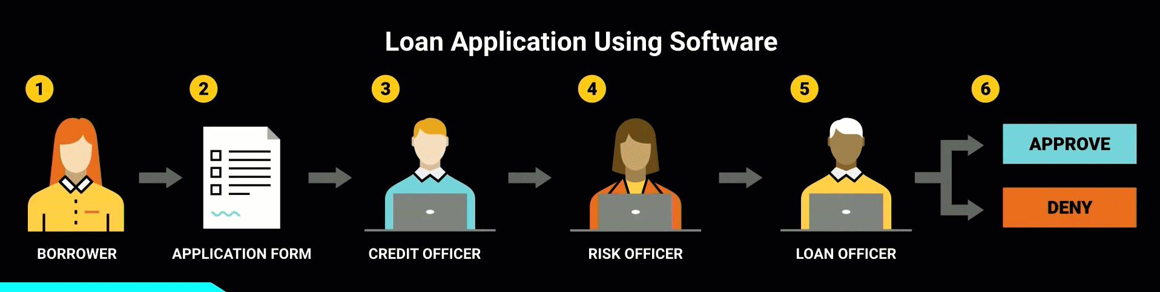
Borrowed from - https://www.youtube.com/watch?v=4QoCbhsQeyE
Notes:
Nowadays, a bank itself is software and takes the decision. Same case earlier humans took decisions using that software. A perfect example would be of sanctioning a personal loan. Things like the CIBIL score, a person’s authenticity available as up-to-date data has provided the power to decide to sanction a loan to machines themselves. Earlier, 1 or more bank employees should do the entire work of analyzing all these.
“Every Company is Becoming software, which were previously just Using the software.”

Slide 35
Can you Answer?
3 AI examples I mentioned in a mobile device.
Notes:
Bots in PUBG
Google Map – route suggestion
Camera – Portrait mode detecting depth.

Slide 36
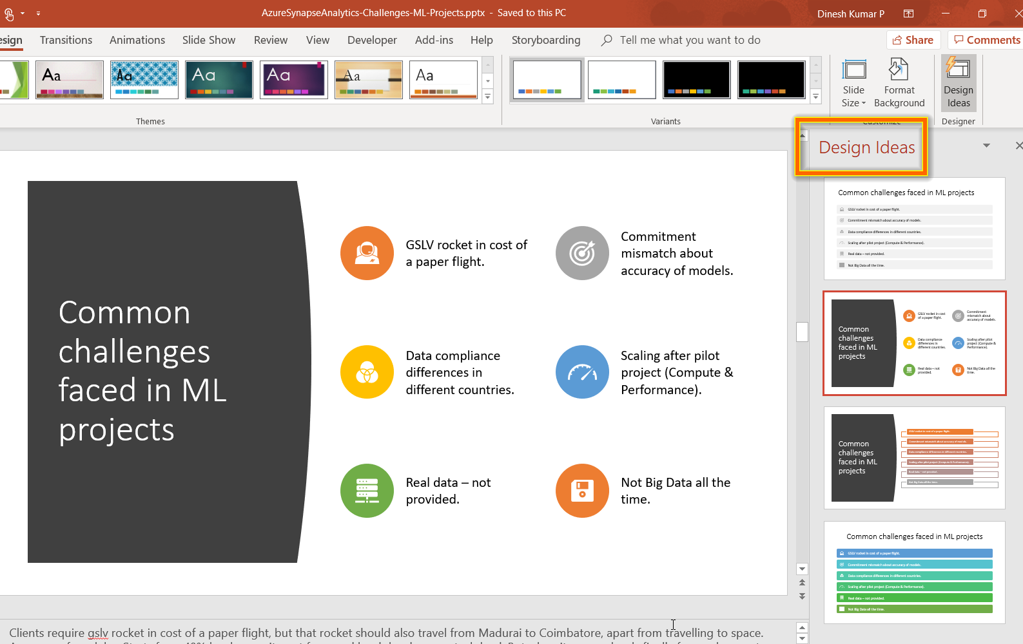
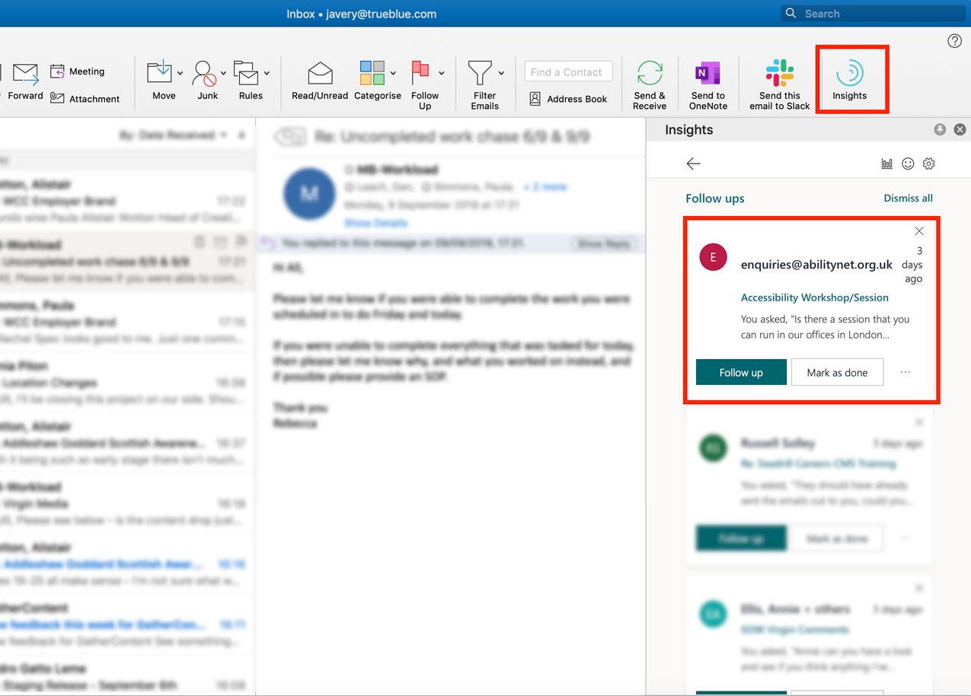
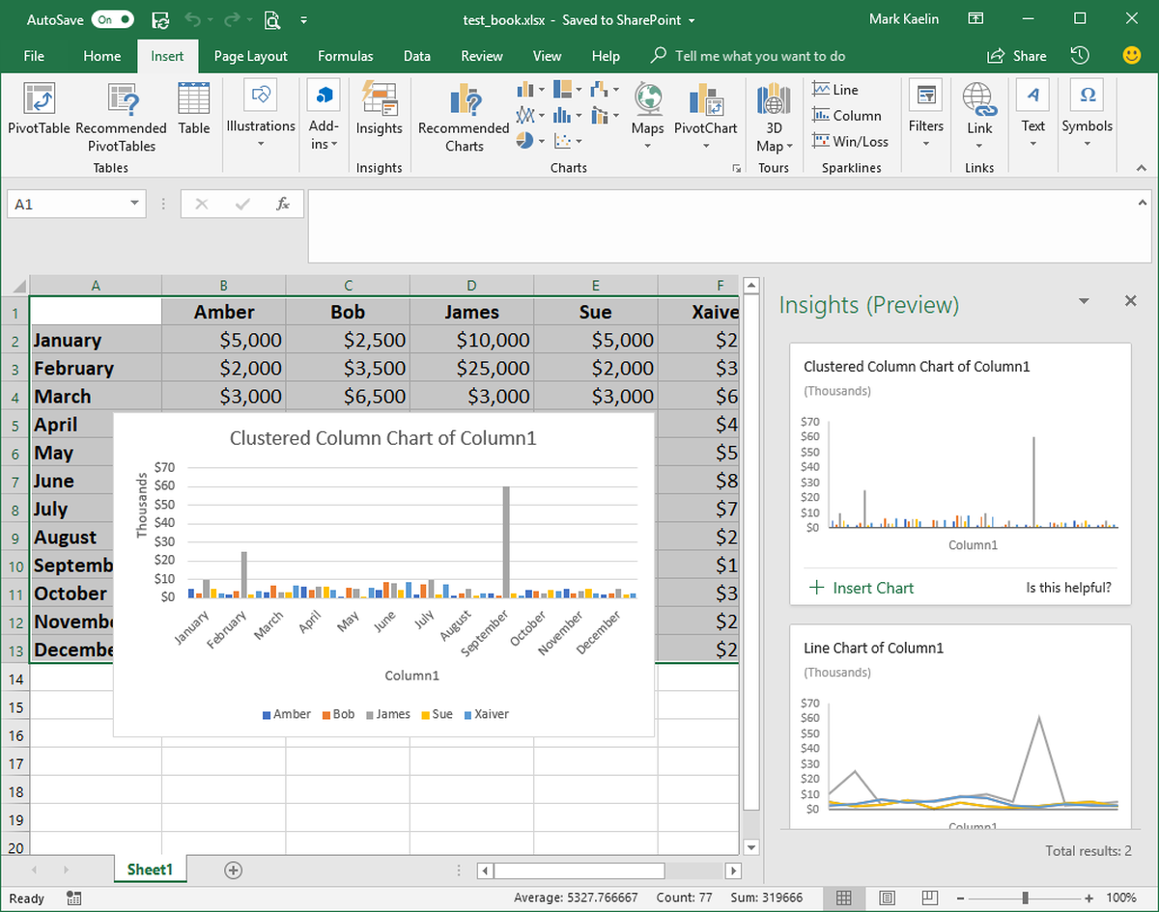
PowerPoint
Outlook
Excel
Notes:
AI is everywhere. As you see in the slide,
‘Design Ideas’ in PowerPoint suggests you good designs and icon sets for the content, in a fraction of second than a human can think.
‘Insights’ in outlook lets you know, if anything you have promised is getting missed out without addressing it.
‘Ideas’ in Excel, automatically decides the suitable chart based on the data you have and populates it right inside of the Excel app automatically.

Slide 37
Can you Answer?
What is the software name that can filter out noise better than a YETI mic with less cost than sound-proof room?
Notes:
Krisp

Slide 38
Can you Answer?
What is the other MS Office App that has AI?
And what is that feature?
Notes:
MS Word
‘Grammar’, ‘Voice to Text’ in 2 voices

Slide 39
Can you Answer?
Repeat the quote present in the slide when I was talking about Bank Loan.
Notes:
Every company is becoming a software company.

Slide 40
Can you Answer?
ML Algorithm for this scenario.
Is this a Bike or Bicycle?
Notes:
Classification algorithm. Since there are only 2 options – Its Binary Classification

Slide 41
Resources
Microsoft Azure Cognitive services
ML.Net
Learning programming languages in Tamil - Python

Slide 42

Thank you!

